Slide 1



Fawry Business Intelligence System
Transaction & Business Performance Analysis Business Intelligence & Data Analytics Project
Prepared by: [ NTI Data Analysis G3 ] 2026
1- Ahmed Yasser 4- Alhusseiny Gaber 2- Ahmed Fathy 5- Kamal Ali
3- Ahmed Abdelhady 6- Ali Mohamed
7- Shahd Ahmed

Slide 2

Business Contextر
Understanding the Fawry ecosystem and its transaction landscape
Fawry operates within Egypt’s digital payments and financial technology ecosystem, connecting customers, merchants, and service providers through digital payment solutions
Transactions take place across multiple services, merchants, payment methods, and digital channels, generating valuable operational and business data
Analyzing this data can help identify transaction trends, evaluate service and merchant performance, and monitor operational efficiency
Customers → Transactions → Services & Merchants → Business Insights

Slide 3
Business Problem
Business Problem
Turning transaction data into actionable business insights
THE CHALLENGE Fawry’s transaction ecosystem generates large volumes of data across different services, merchants, payment methods, and transaction channels. Without a centralized analytical view, identifying performance trends and business opportunities can be challenging
KEY QUESTIONS 1- Which services generate the highest transaction volume and revenue?
2- Which merchants contribute the most to overall transaction performance?
3- What are the most commonly used payment methods and devices?
4- How does transaction performance change over time?
5- What factors are associated with failed or slow transactions?
Our Goal: Transform raw transaction data into meaningful insights that support data-driven decision-making.

Slide 4
Project Objectives
1 - Transaction Analysis
Analyze transaction activity and identify trends across time, status, payment methods, and devices
02 — Service Performance
Evaluate service performance and identify the most frequently used and highest-value services
03 — Merchant Performance
Assess merchant activity and identify top-performing merchants and business segments
04 — Operational Efficiency
Monitor processing time and transaction status to identify potential performance issues
05 — Interactive BI Solution
Build an interactive Power BI dashboard that transforms analytical findings into actionable insights
Analyze → Measure → Compare → Visualize → Decide

Slide 5
Dataset & Data Structure
From raw records to analysis-ready data
Original Data
Transactions
10 original fields
Services
4 fields
Merchants
7 fields
Transaction ID - Service ID Merchant ID - Amount Fawry Fee -Transaction Date – Status - Payment Method - Device Type - Processing Time
Service ID Service Name Service Provider Merchant ID
Merchant ID - Merchant Name - Phone Number - Contract Date - Merchant Type – Region - POS Status

Slide 6
End-to-End Data Analytics Workflow
Transforming raw transaction data into actionable business insights
1 _ Raw Data
Transaction
Services
Merchants
2 _ Python
EDA
Data Cleaning
Feature Engineering
Merchant RFM
3 _ SQL
Database
Design
Data Loading
Foreign Keys
SQL Queries & Joins
Schema
4 _ Power BI
Data
Modeling
Interactive
Visualization
KPI
Dashboards
5 _ Business Insights
Performance
Analysis
Trends & Patterns
Data-Driven Decisions

Slide 7
Python — Exploratory Data Analysis
PYTHON • EDA
Profiling the transaction data before cleaning and modeling
Data Profiling
Data Quality Checks
Outlier Analysis
Shape, structure and sample inspection
Data types and non-null counts
Descriptive statistics
Null-value and duplicate checks
Status categories reviewed
Payment methods reviewed
Fawry Fee distribution inspected
Processing Time distribution inspected
Boxplots used for Fawry Fee
Boxplots used for Processing Time
IQR method used to identify outliers
Outlier counts prepared for review
EDA objective: understand data quality and distributions before transformation.
8

Slide 8
Data Cleaning
PYTHON • CLEANING
Standardizing values and preparing a reliable analytical dataset
01 Amount
02 Missing Values
03 Dates
Extract numeric values and convert to numeric type.
Fill missing Amount and Fawry_Fee using the mean.
Convert Transaction_Date to datetime and standardize mixed formats.
04 Consistency
05 Payment Method
06 Data Type
Correct Panding → Pending and Succes → Success.
Correct the Credit Card spelling/spacing issue.
Convert Merchant_ID to integer.
9

Slide 9
Feature Engineering
PYTHON • FEATURES
Time Features
Financial Features
Operational Features
Year
Month & Month Name
Day & Day Name
Time
Hour
Total Price = Amount + Fawry Fee
Fee Rate = Fawry Fee / Total Price
Price Category: Low / Medium / High / Very High
Processing Speed: Fast / Normal / Slow
Success Status: Success / Failed / Pending
Derived fields prepared for BI analysis
10

Slide 10
Merchant RFM Analysis
PYTHON • RFM
RECENCY
FREQUENCY
MONETARY
Days since the merchant's latest transaction.
Lower recency indicates more recent activity.
Count of transactions per merchant.
Higher frequency indicates more active merchants.
Sum of Total Price per merchant.
Higher monetary value indicates greater transaction value.
R / F / M scores were assigned using quintiles to support merchant segmentation.
11

Slide 11
SQL — Database & Analysis
SQL • DATABASE
Structuring the data in MySQL and applying relational queries
Database Design
Data Loading
SQL Analysis
Transactions as central fact table
Services and Merchants as related tables
Primary key: Transaction_ID
Foreign keys: Service_ID, Merchant_ID
CSV files loaded with LOAD DATA INFILE
UTF-8 encoding supported
Date fields converted during loading
Cleaned transaction data imported
Filtering & sorting
Aggregations: SUM / AVG / MIN / MAX / COUNT
GROUP BY & HAVING
CASE, subqueries and multiple JOIN types
12

Slide 12
Power BI — Data Model
POWER BI • MODEL
TRANSACTIONS
SERVICES
MERCHANTS
Transaction_ID
Service_ID
Merchant_ID
Amount
Fawry_Fee
Transaction_Date
Status
Payment_Method
Service_ID
Service_Name
Service_Provider
Merchant_ID
Merchant_ID
Merchant_Name
Merchant_Type
Region
POS_Status
Service_ID and Merchant_ID connect transaction activity to business context.
13

Slide 13
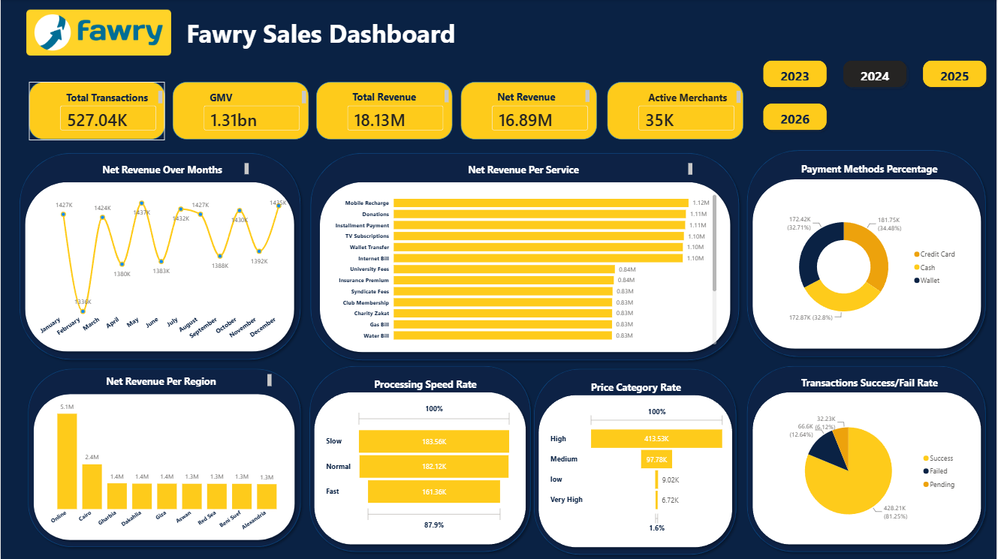
Power BI — Fawry Sales Dashboard
POWER BI • DASHBOARD
14

Slide 14
Dashboard Highlights
POWER BI • KPIs
The dashboard consolidates the most important business performance indicators
TOTAL TRANSACTIONS
2M
GMV
4.96bn
TOTAL REVENUE
68.82M
NET REVENUE
64.11M
ACTIVE MERCHANTS
35K
Revenue & Service Performance
Transaction & Operational Performance
January shows the highest monthly net revenue at approximately 20M.
Net revenue per service is led by a group of services at approximately 4.2M each.
Online region leads regional net revenue at approximately 19.2M.
Success rate is approximately 81.3%; failed and pending transactions account for the remainder.
Payment methods are relatively balanced across Credit Card, Cash, and Wallet.
Slow and Normal transactions each exceed 690K, indicating a meaningful operational monitoring area.
15

Slide 15
Key Insights & Business Recommendations
INSIGHTS → ACTION
Key Insights
Recommendations
January is a clear revenue peak, while monthly net revenue is lower across the rest of the year.
Online region generates the highest net revenue among the displayed regions.
High-price transactions dominate the Price Category distribution.
Success is the majority outcome, but failed and pending transactions remain material.
Payment method usage is broadly distributed rather than concentrated in one method.
Investigate the drivers behind the January revenue spike and assess whether they can be replicated.
Prioritize high-value services and merchant segments for growth initiatives.
Monitor failed and pending transactions by service, merchant, and payment method.
Review slow processing paths and target operational bottlenecks.
Use Merchant RFM scores to prioritize retention and engagement actions.
16

Slide 16
Fawry Business Intelligence System
From raw transaction data to actionable business intelligence
Python • SQL • Power BI
Thanks
17

